Slide 1
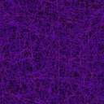


UNIVERSITY COLLEGE OF ENGINEERING,
OSMANIA UNIVERSITY
DEPARTMENT OF BIOMEDICAL ENGINEERING
PUPILLOMETER FOR AUTOMATED DETECTION OF RELATIVE AFFERENT PUPILLARY DEFECT
INTERNAL GUIDE:
Prof: DR.D.SUMAN
TEAM MEMBERS:
PAVANI THADEM – 100519731022
CHILMULA DHARANI – 100519731082
SRIVOJU VAISHNAVI – 100519731084

Slide 3


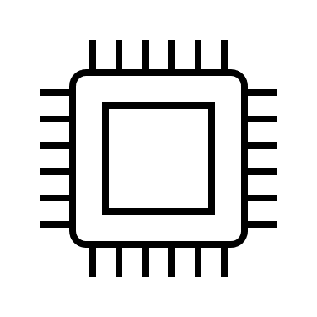
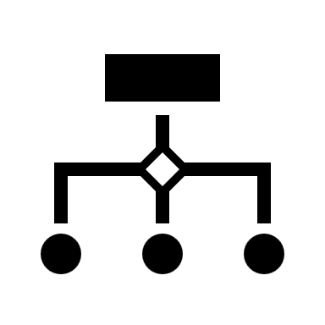

ABSTRACT
INTRODUCTION
COMPONENTS
METHODOLOGY
CONCLUSION

Slide 4
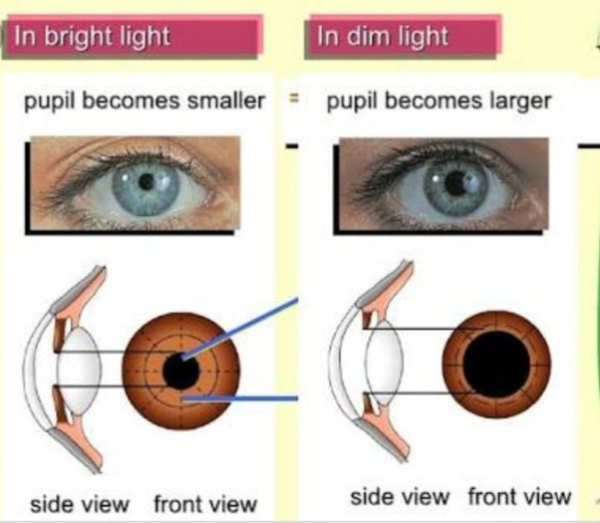
Abstract
The presence of Relative Afferent Pupillary Defect (RAPD) indicates serious ocular disease. It is caused due to any damage to the Afferent pupillary pathways that are responsible for transmitting signals of presence of light from eye to brain. The proper identification and interpretation of RAPD helps the clinician to estimate the degree of damage and also in evolution of the treatment process. Though SFT has been a traditional way of testing for RAPD since decades, as there is no quantification and being a subjective test, the assessment depends on the experience of the clinician. The result is the development of a pupilometer which objectively performs the test. Till now we have designed Pupilometer device which is semi automated , uses custom built hardware and software to perform the test with an objective of determining the diameter of pupil and capable of diagnosing RAPD at an early stage. Now we are going to propose fully automated pupilometer with grading of RAPD. The hardware of the device consists of components to produce a light stimulus into each eye and record the response of the pupils to the stimulus. Software developed is responsible for the timing of the stimulus, processing the recorded response of the pupil in calculating the diameter of pupil. Statistical analysis is done on few subjects ,the results obtained to verify the utility of the device.

Slide 5
Limitations of Swinging flashlight test:
It requires a considerable amount of expertise by the examiner, especially in the detection of subtle defects.
Difficulties in assessment of this test lie in patients with anisocoria, dark irises or very small pupils.
Young patients may also exhibit hippus, which causes slight fluctuations in pupil size despite constant light stimulation.

Slide 6
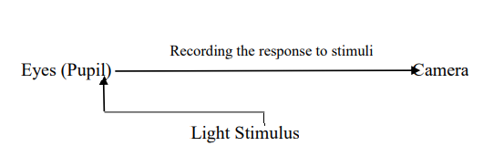
Project Conceptualization
The design of the pupilometer device records the constriction of the pupil of eye when light falls on it
The device is adjusted correctly so that the pupils of both eyes are visible correctly in the window. The stimulus alternates between both eyes by lasting in front of each eye for five seconds and a rapid alternation with a gap of three seconds between each stimulus pair.
The cameras present inside the device records a live video of pupil of each eye when they are reacting to light stimulus.
Once the photographs of eye are taken automatically the further image processing is done and the diameter of the pupil is compared between the eye and displays RAPD status.
Recording of video and taking photographs are done by the visual studio open cv and the further process was done by the visual studio python programming.
Concept of the device

Slide 7
Methodology
Capturing the pictures using program
Thresholding and croping
Detecting the pupil radius of two eyes
Comparing the radius of two eyes
If : <1
No: YES RAPD
Yes: NO RAPD

Slide 8
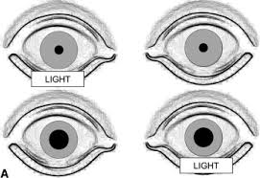
Importance of testing RAPD
Relative Afferent Pupillary Defect is an extremely important clinical sign and testing it is important. When tested, and interpreted correctly –
• The presence of RAPD serves as an evidence of serious disease.
• The grading of RAPD is a useful indicator of the degree of damage that occurred in a diseased Optic Nerve.
• A measured and documented pupil defect will be a value in following patient with RAPD; because today’s defect can be compared to the defect measured in other occasions, and it tells us whether there is any subsequent worsening or improvement of damage.
• It is an objective test to visual function and its presence indicates visual deficit in that eye and since, long times we have also know that pupil of blind eye does not react. So, RAPD has a major role in determining the ocular health status.

Slide 9
Components
Arduino UNO
camera
White LEDs
Connecting wires
Power bank

Slide 10
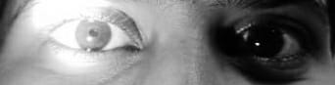

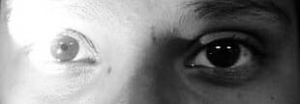

Data collection
Fig:1.1
Fig:1.2
Fig:2.1
Fig:2.2
Left and Right eye of the subjects when light is stimulated on eye

Slide 11
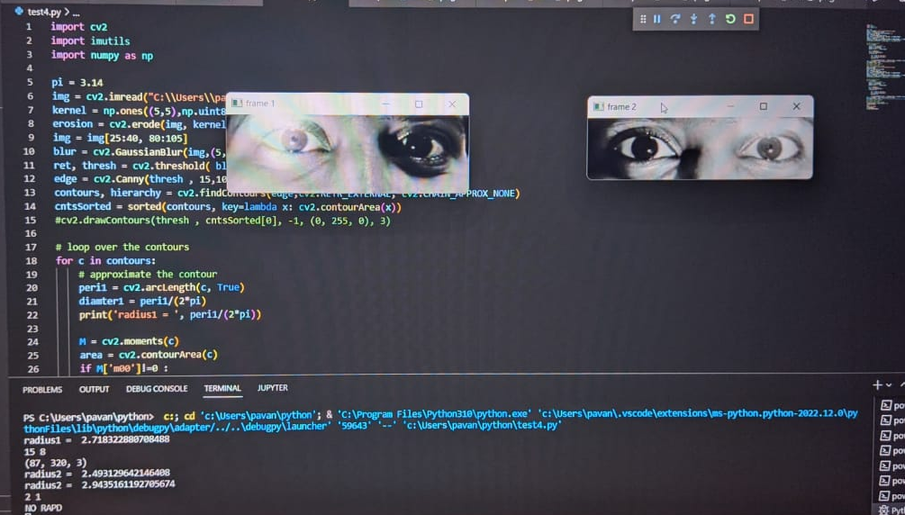
Fig: output after processing the data collected

Slide 12
References
Clinical Anatomy of the Eye; Second Edition – Richard S. Snell, Michael A. Lemp
Clinical Anatomy of the Visual System; Second Edition – LEE ANN REMINGTON
Jack J Kanski Clinical Ophthalmology; Sixth Edition
Bell, Raymond A., et al. "Clinical grading of relative afferent pupillary defects." Archives of Ophthalmology 111.7 (1993): 938-942
http://www.richmondeye.com/clinical-content-the-relative-afferentpupillary-defect/
Thompson, H. Stanley, and James J. Corbett. "Asymmetry of pupillomotor input." Eye 5.Pt 1 (1991): 36-9
Cox, Terry A. "Pupillary escape." Neurology 42.7 (1992): 1271-1271.
Enyedi, Laura B., Sundeep Dev, and Terry A. Cox. "A comparison of the Marcus Gunn and alternating light tests for afferent pupillary defects. “Ophthalmology 105.5 (1998): 871-873.
Graefe, A.; Mitteilungen vermischten Inhalts: 12: Ueber ein einfaches Mittel, Simulation einseitiger Amaurose zu entdecken, nebst Bemerkungen ueber die Pupillar-Kontraction b^i Erblindeten. Arch. f. Ophth. 2:266 (pt. 1) 1855

Slide 13
References
Baquis, E. "La reazione pupillare come elemento diagnostico differenziale tra l'amaurosi isterica e quella da nevrite retro-bulbare." Ann. Ottal 30.3 (1901): i901
Gunn, R. Marcus, et al. "Discussion on retro-ocular neuritis." The British Medical Journal (1904): 1285-1287.
Kestenbaum, Alfred. Clinical methods of neuro-ophthalmologic examination. Elsevier, 2013.
LEVATIN, PAUL. "Pupillary escape in disease of the retina or optic nerve."AMA Archives of Ophthalmology 62.5 (1959): 768-779
Thompson, H. Stanley. "Afferent pupillary defects: Pupillary findings associated with defects of the afferent arm of the pupillary light reflex arc."American journal of ophthalmology 62.5 (1966): 860-87
Gerold, Hugo. Die Lehre vom schwarzen Staar u. dessen Heilung. Rubach, 1846 [11]Hirschberg, J. "Neuritis retrobulbaris." Z. Prak. Augenh 8 (1884): 185.

Slide 14
THANK YOU

